Slide 1

Development of machine learning models to process Electronic Health Records – Explainable Models
Week 8 Meeting, 22/11/2021

Slide 2
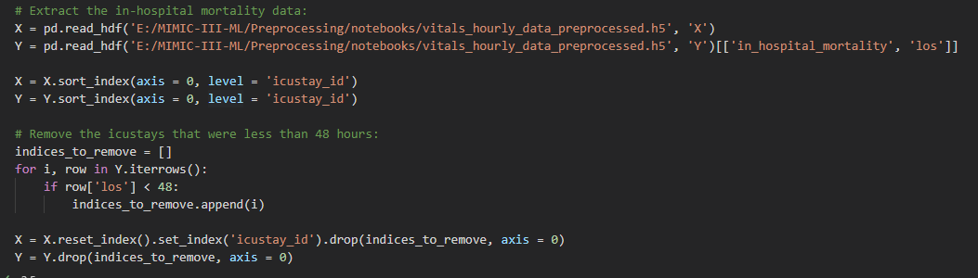
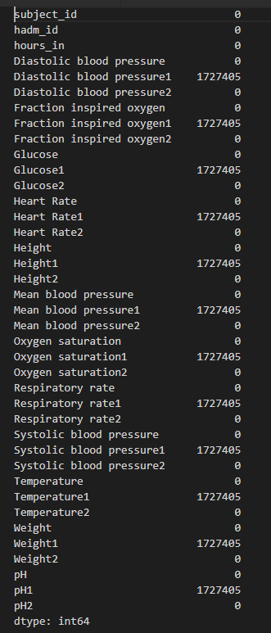


Duplicate column, with null values

Slide 3
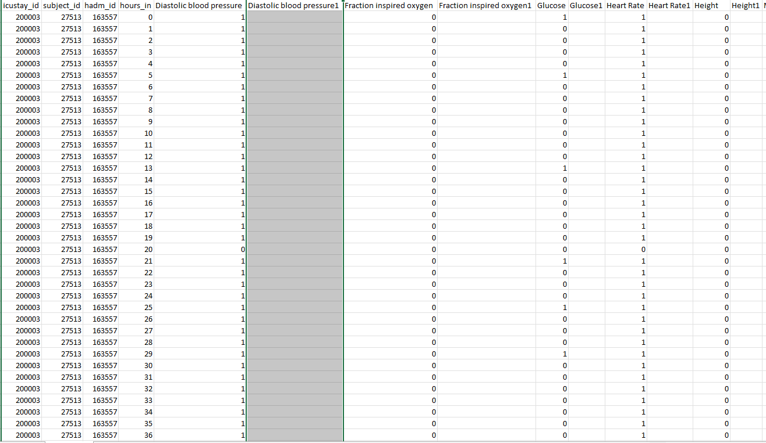
Duplicate rows for same patient
There are multiple entries for the icu stay for each hour
One patient has multiple row
Multiple instances of where mortality is 0
Should we be trimming it down to one data per patient?

Slide 4
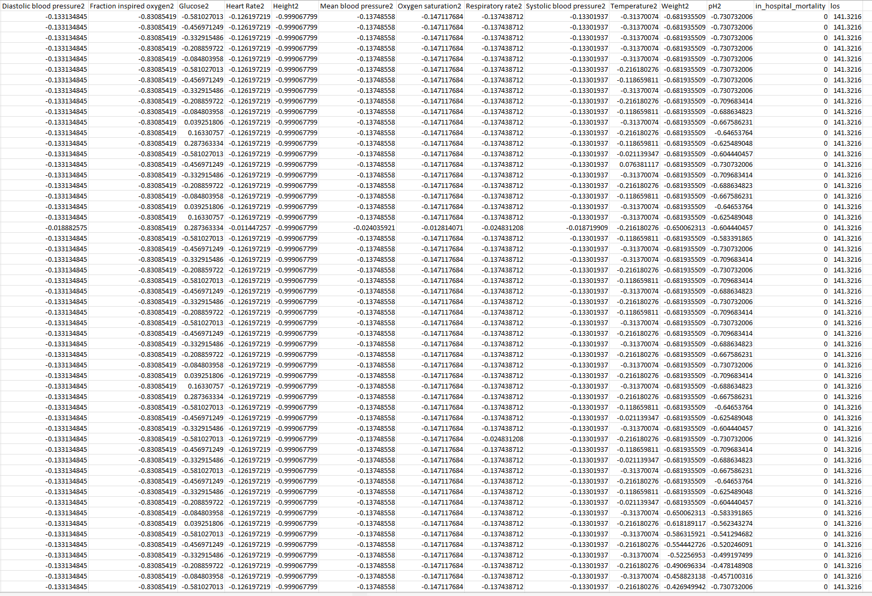
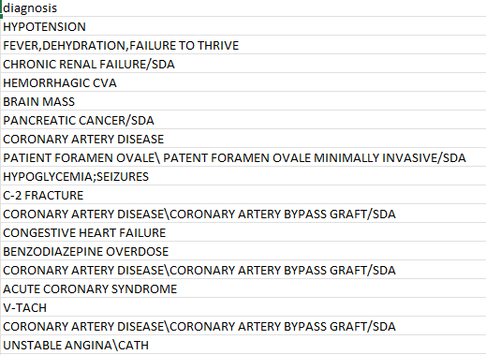
Training Data
Is this the only part of the data I should be training on?
In in some static data?
Age?
Ethnicity?
Diagnosis?

Slide 5
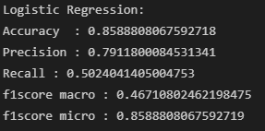
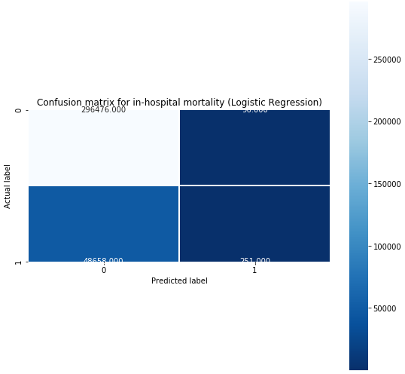
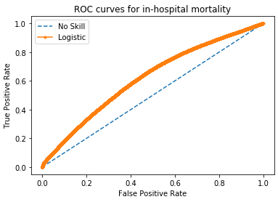
Machine learning (Logistic regression model)
From looking at the confusion matrix, most data is strictly predicted as 0
The train data is inbalanced.

Slide 6
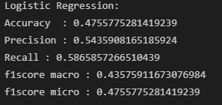
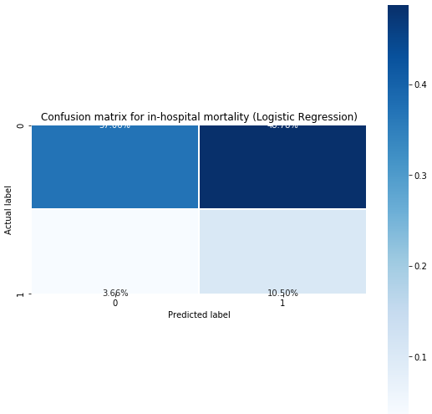
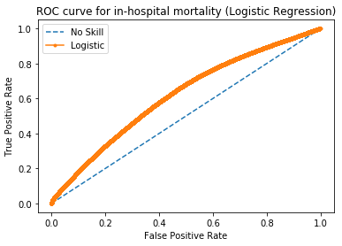
Solving class imbalance
Tried using the undersample_majority function from the notebooks but couldn’t get it to work
Did some research and used class_weight='balanced’
Looks a lot more balanced now but accuracy dropped by alot

Slide 7
Before moving on to deep learning
Am I on the right track?
Should I focus on finalizing the features before moving on to comparing different models
Project Aims:
Use current state-of-the-art machine learning models to train a model to predict the risk of mortality
Develop mechanisms based on global and local interpretability to explain the outcome of the models and identify risk factors

